Slide 1
National Economic Education Delegation
Vision
  One day, the public discussion of policy issues will be grounded in an accurate perception of the underlying economic principles and data.
Mission
  NEED unites the skills and knowledge of a
  vast network of professional economists to promote understanding of the economics of policy issues in the United States.
NEED Presentations
  Are nonpartisan and intended to reflect the consensus of the economics profession.

Slide 2
International Trade and the Pandemic
Alan V. Deardorff
University of Michigan
For presentation to Osher Lifelong Learning Institute
Sonoma State University
April 28, 2021

Slide 3
Overview
Cases
  Started in China
  Spread to the world in two (or three) waves, so far
  Hit the Americas and Europe especially hard
  Deaths surged early and then grew more slowly than cases as treatments improved

Slide 4
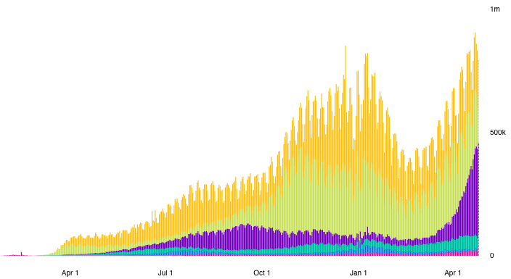
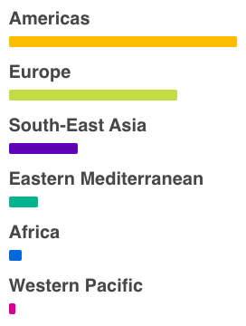
Cases
Daily Confirmed Cases
Source: WHO Coronavirus Disease (COVIC-19) Dashboard as of Apr 26, 2021
Notes:
WHO Coronavirus Disease (COVIC-19) Dashboard
https://covid19.who.int/?gclid=CjwKCAiAuoqABhAsEiwAdSkVVNd67qw_hEb4v9v3UxACJd_csZMJl8Yc5UjaAIYt53KJWSQiXZPlRxoCm0kQAvD_BwE

Slide 5
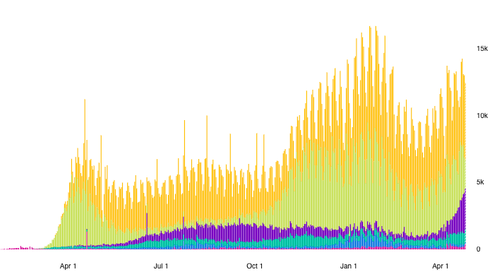
Deaths
Daily Deaths
Source: WHO Coronavirus Disease (COVIC-19) Dashboard as of Apr 26, 2021
Notes:
WHO Coronavirus Disease (COVIC-19) Dashboard
https://covid19.who.int/?gclid=CjwKCAiAuoqABhAsEiwAdSkVVNd67qw_hEb4v9v3UxACJd_csZMJl8Yc5UjaAIYt53KJWSQiXZPlRxoCm0kQAvD_BwE

Slide 6
Overview
Trade Policy Responses
  Included both
    Import facilitation, and
    Export restriction
  Both highest for medical and high for food
  Facilitation was somewhat more common than restriction
  Both began before cases surged

Slide 7
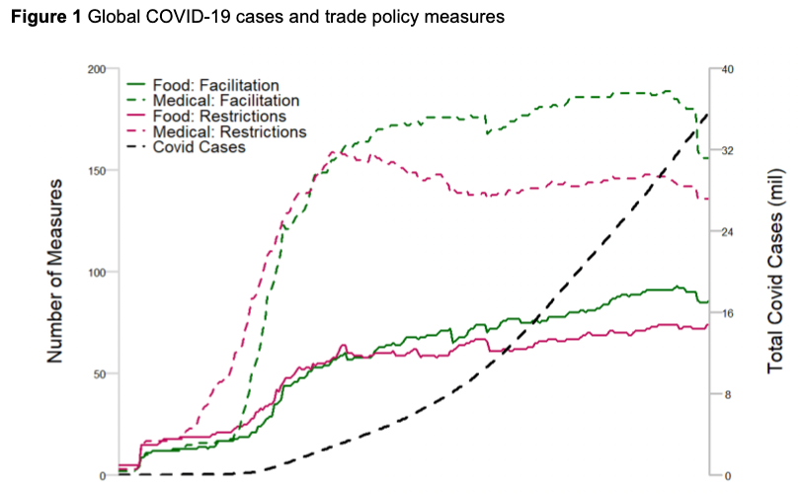
Medical
Food
Source: Evenett et al.
Notes:
Evenett, Simon, Matteo Fiorini, Johannes Fritz, Bernard Hoekman, Piotr Lukaszuk, Nadia Rocha,Michele Ruta, Filippo Santi, Anirudh Shingal, “Trade policy responses to the COVID-19 pandemic: Evidence from a new dataset,” VOXEU, December 11, 2020.
https://voxeu.org/article/trade-policy-responses-covid-19-pandemic-new-dataset

Slide 8
International Trade and the Pandemic
Outline
Pros and Cons of Trade
  Globalization
Causes of the Pandemic
Effects of the Pandemic
  On Economies, Including Trade
  On Trade Policies
Role of Trade During the Pandemic
  PPE and medical supplies
  Vaccines

Slide 9
Trade Pros and Cons

Slide 10
Pros and Cons of Trade
Pros
  Reduces cost-of-living world-wide
Cons
  Changes internationally hurt some while helping others
Economists’ almost universal view: Pros > Cons
  Trade is beneficial overall for all countries
  Trade restrictions are harmful
    Tariffs on imports, export taxes
    Bans on exports, imports
  But there are always losers from changes in trade who need policies to help them
Notes:
Salvatore Babones, “The ‘Chinese Virus’ Spread Along the New Silk Road,” Foreign Policy, April 6, 2020.
https://foreignpolicy.com/2020/04/06/chinese-coronavirus-spread-worldwide-on-new-silk-road/

Slide 11
Pros of Trade
Comparative advantage
  Source goods where relative costs are lowest
  Each country produces and exports what they do best
  Costs and prices fall world-wide
Increased competition
  More firms compete, reducing monopoly pricing
Economies of large-scale production
  With larger markets firms reap economies of scale
  Costs fall
Notes:
Salvatore Babones, “The ‘Chinese Virus’ Spread Along the New Silk Road,” Foreign Policy, April 6, 2020.
https://foreignpolicy.com/2020/04/06/chinese-coronavirus-spread-worldwide-on-new-silk-road/

Slide 12
Pros of Trade
Access to greater variety
  Products can be better-tailored to users needs
  Consumers get what they want most
  Producers get what they need most
Increases productivity
  Firms learn state-of-the-art technologies from foreign firms
  Most productive firms expand while others contract
Notes:
Salvatore Babones, “The ‘Chinese Virus’ Spread Along the New Silk Road,” Foreign Policy, April 6, 2020.
https://foreignpolicy.com/2020/04/06/chinese-coronavirus-spread-worldwide-on-new-silk-road/

Slide 13
Cons of Trade
Changes in trade (up or down) disrupt
  Businesses
  Jobs
  Communities that lose factories to
    Imports
    Movement to produce abroad
Notes:
Salvatore Babones, “The ‘Chinese Virus’ Spread Along the New Silk Road,” Foreign Policy, April 6, 2020.
https://foreignpolicy.com/2020/04/06/chinese-coronavirus-spread-worldwide-on-new-silk-road/

Slide 14
Cons of Trade
Dependence on foreign supply and demand
  Trade can be disrupted by
    Natural disasters (earthquakes, floods, etc.)
    Policies (export and import bans or taxes)
  International cartels (oil crises of the 1970s)
Vulnerable to others’ economies, diseases
  Recession in export markets causes recession at home
  Exchange rate changes can cause inflation, unemployment
  Infectious diseases spread through trade
Notes:
Salvatore Babones, “The ‘Chinese Virus’ Spread Along the New Silk Road,” Foreign Policy, April 6, 2020.
https://foreignpolicy.com/2020/04/06/chinese-coronavirus-spread-worldwide-on-new-silk-road/

Slide 15
Globalization
How and why trade has grown
  Trade grew, then fell, then grew vastly
  Tariffs and other barriers have fallen
Notes:
Salvatore Babones, “The ‘Chinese Virus’ Spread Along the New Silk Road,” Foreign Policy, April 6, 2020.
https://foreignpolicy.com/2020/04/06/chinese-coronavirus-spread-worldwide-on-new-silk-road/

Slide 16
Notes:
https://ourworldindata.org/grapher/globalization-over-5-centuries?country=~OWID_WRL

Slide 17
US Tariffs, 1891-2017
Tokyo Round tariff cuts
Smoot-Hawley
GATT
established
Kennedy Round tariff cuts begin
Uruguay Round
Notes:
From NEED trade deck

Slide 18
Causes of the Pandemic

Slide 19
Causes of the Pandemic
Does trade cause new infections?
  No. These arise from mutations, often in animals and then spread to humans
Does trade spread infections?
  Yes. Trade requires movement of people across borders, carrying infections
  The Black Death (bubonic plague)
    “is believed to have been spread by both land and sea, originating in China and following the trade routes to Europe and the Middle East.”
  The 1918 Spanish Flu: but spread more by soldiers than by trade
Notes:
Salvatore Babones, “The ‘Chinese Virus’ Spread Along the New Silk Road,” Foreign Policy, April 6, 2020.
https://foreignpolicy.com/2020/04/06/chinese-coronavirus-spread-worldwide-on-new-silk-road/

Slide 20
Causes of the Pandemic
Studies Relate Globalization and Spread of Pandemic
  Zimmermann et al. find, across countries:
    Infection rate rises with globalization
    Transmission speed rises with globalization
    Fatalities fall with globalization
      (but probably because globalization is correlated with higher incomes and thus better treatment)
  Farzanegan et al. report similarly
Notes:
Zimmermann, Klaus F., Gokhan Karabulut, Mehmet Huseyin Bilgin, and Asli Cansin Doker, “Inter-country distancing, globalisation and the coronavirus pandemic,” World Economy 43(6), June 2020, pp. 1484-1498.
Farzanegan, Mohammad Reza, Mehdi Feizi, and Hassan F. Gholipour, “Globalization and Outbreak of COVID-19: An Empirical Analysis,” CESifo Working Paper No. 8315, May 2020.

Slide 21
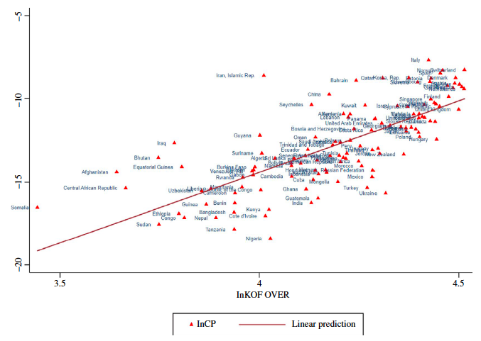
    Infection rates rise with globalization
Infection Rate
(Globalization)
Source: Zimmermann et al. (2020)
Notes:
Zimmermann, Klaus F., Gokhan Karabulut, Mehmet Huseyin Bilgin, and Asli Cansin Doker, “Inter-country distancing, globalisation and the coronavirus pandemic,” World Economy 43(6), June 2020, pp. 1484-1498.

Slide 22
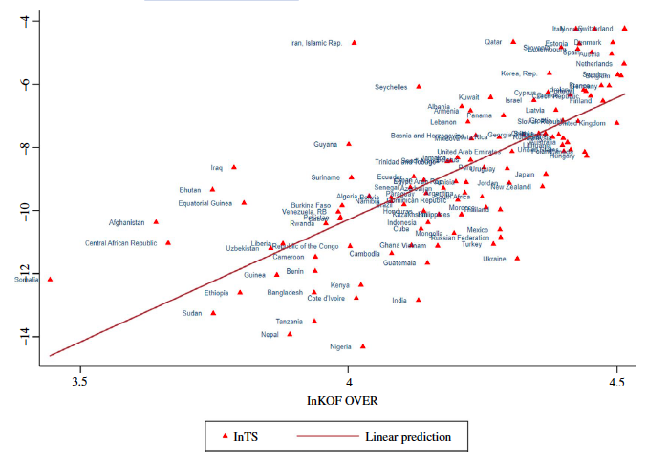
    Transmission speed rises with globalization
Transmission Speed
(Globalization)
(Globalization)
Source: Zimmermann et al. (2020)
Notes:
Zimmermann, Klaus F., Gokhan Karabulut, Mehmet Huseyin Bilgin, and Asli Cansin Doker, “Inter-country distancing, globalisation and the coronavirus pandemic,” World Economy 43(6), June 2020, pp. 1484-1498.

Slide 23
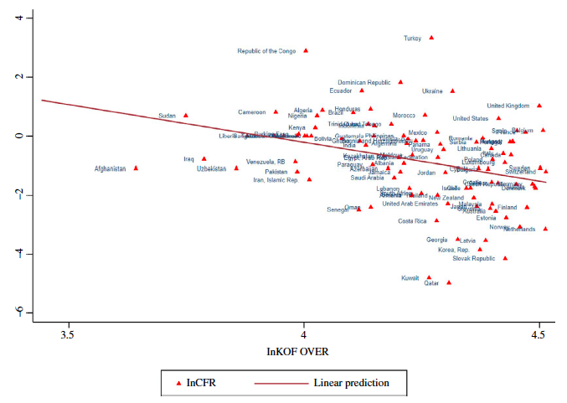
    Fatalities fall with globalization
Fatality Ratio
(Globalization)
(Globalization)
Source: Zimmermann et al. (2020)
Notes:
Zimmermann, Klaus F., Gokhan Karabulut, Mehmet Huseyin Bilgin, and Asli Cansin Doker, “Inter-country distancing, globalisation and the coronavirus pandemic,” World Economy 43(6), June 2020, pp. 1484-1498.

Slide 24
Causes of the Pandemic
Globalization and Spread of Pandemic
  Note that globalization is not just trade
  It includes
    International trade and investment
    International tourism
    International students
    Migration
    International transportation
Notes:
Zimmermann, Klaus F., Gokhan Karabulut, Mehmet Huseyin Bilgin, and Asli Cansin Doker, “Inter-country distancing, globalisation and the coronavirus pandemic,” World Economy 43(6), June 2020, pp. 1484-1498.

Slide 25
Effects on Economies

Slide 26
Effects on Economies
Effects of the Pandemic on Economies
  Trade plummets
  Travel halted
  Shipping declines
  Supply chains disrupted
  GDP (if time)
  Unemployment (if time)

Slide 27
Trade
Effects on Economies

Slide 28
Effects on Economies
Trade
  Pandemic was expected to reduce world trade, and did
  US was typical; China, was not
  Trade with China was crucial for dealing with pandemic
  Trade in many products were affected
  Global trade has now recovered

Slide 29
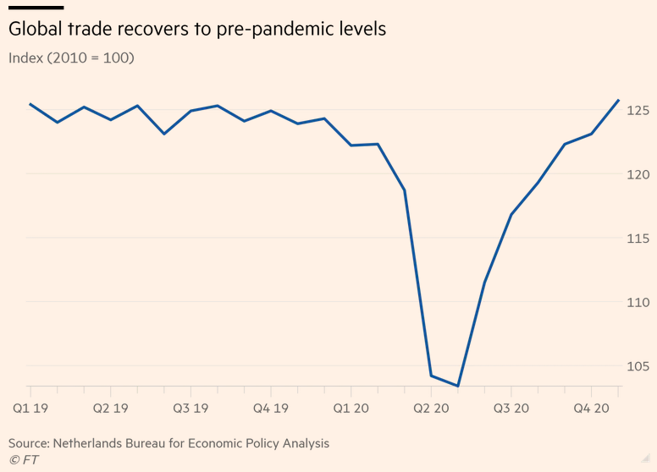
Source:
Financial Times,
Jan 25, 2021
Notes:
Romei, Valentina, “Global trade recovers to pre-pandemic level,” Financial Times, January 25, 2021
https://www.ft.com/content/add4d744-30da-4df4-b703-80488c1b3104

Slide 30
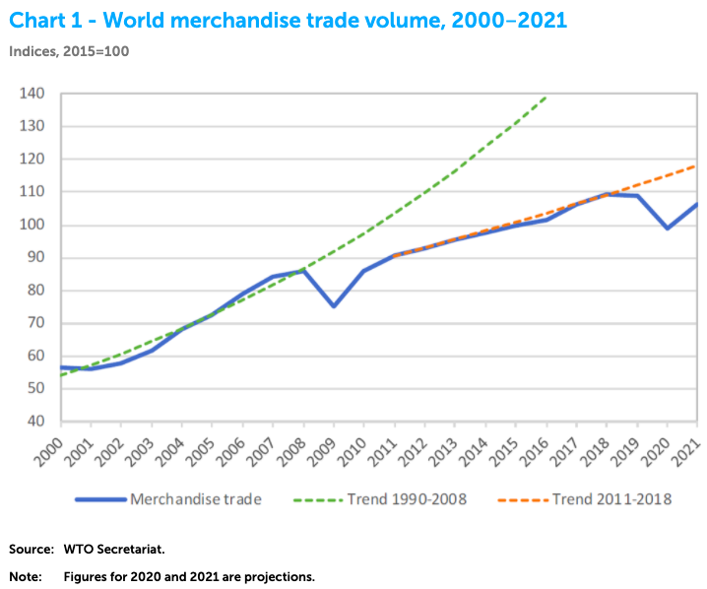
Source: WTO
Oct 6, 2020
Notes:
WTO, Oct 6. 2020
https://www.wto.org/english/news_e/pres20_e/pr862_e.htm

Slide 31
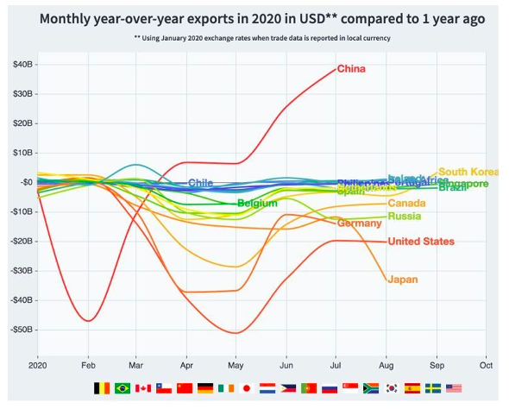
Source: World Economic Forum
Nov 8, 2020
Notes:
How COVID-19 has affected trade, in 8 charts, World Economic Forum, Nov 8, 2020
https://www.weforum.org/agenda/2020/11/how-covid-19-has-reshuffled-international-trade/

Slide 32
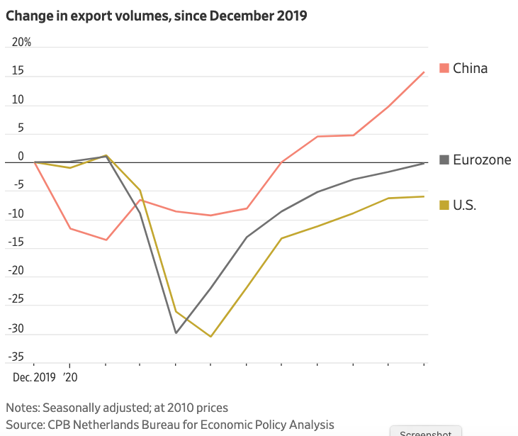
Source: Wall Street Journal
Feb 26, 2021
Notes:
Hannon, Paul, “Global Trade Roars Back From Depths of Covid-19 Pandemic,” Wall Street Journal, February 26, 2021.
https://www.wsj.com/articles/global-trade-roars-back-from-depths-of-covid-19-pandemic-11614253037?mod=itp_wsj&ru=yahoo

Slide 33
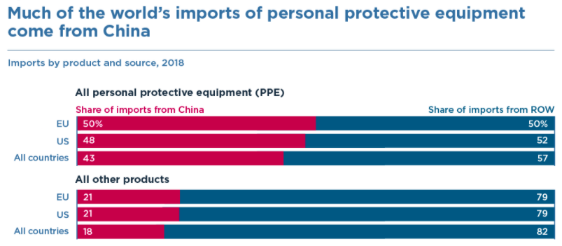
Source: Bown (2020)
Notes:
Bown (2020), “COVID-19: China's exports of medical supplies provide a ray of hope,” PIIE
https://www.piie.com/blogs/trade-and-investment-policy-watch/covid-19-chinas-exports-medical-supplies-provide-ray-hope

Slide 34
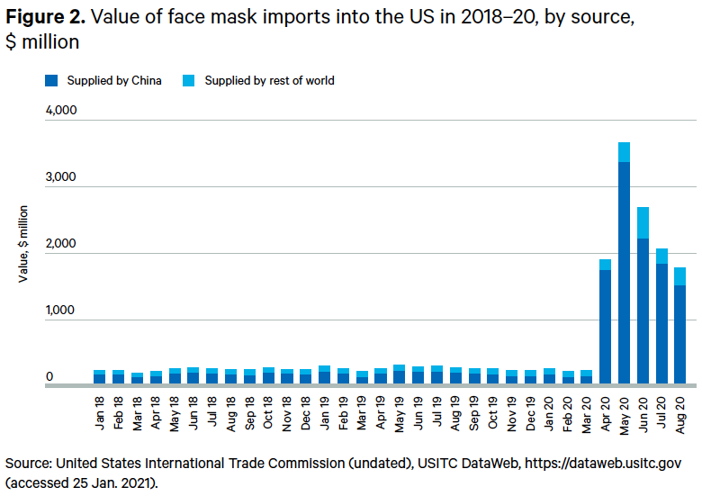
Source: Evenett (2021)
Notes:
Evenett, Simon J., “Trade policy and medical supplies during COVID-19,” Briefing Paper, Global Economy and Finance Program, Chatham House, April 2021
https://www.globaltradealert.org/reports/67

Slide 35
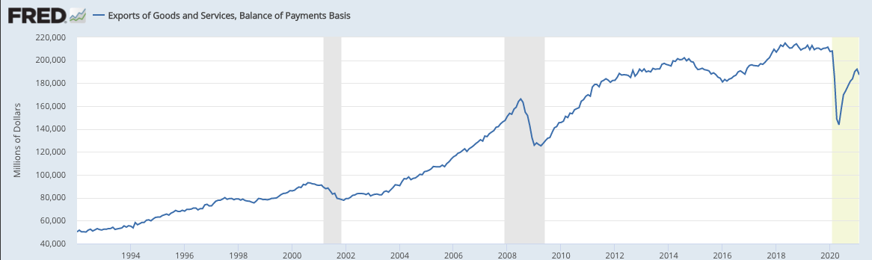
US Exports of Goods and Services, Balance of Payments Basis
Source: FRED Apr 7, 2021
Notes:
FRED, Apr 7, 2021, Downloaded Apr 26, 2021
https://fred.stlouisfed.org/series/BOPTEXP

Slide 36
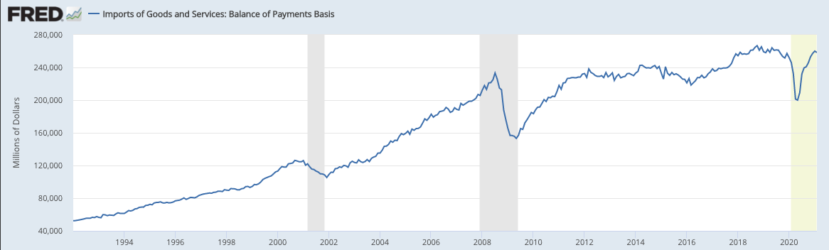
US Imports of Goods and Services, Balance of Payments Basis
Source: FRED Apr 7, 2021
Notes:
FRED, Apr 7, 2021, Downloaded Apr 26, 2021
https://fred.stlouisfed.org/series/BOPTIMP

Slide 37
Top US Trade Partners (Goods, 2018)
Top 10 US export destinations
Top 10 US import sources
Notes:
From NEED trade deck

Slide 38
Travel
Effects on Economies

Slide 39
Effects on Economies
Travel
  Fell drastically and has only partially recovered
  Symptoms
    Passengers
    Airline stock prices
  Reasons:
    Travel restrictions and border closures
    Delays at border

Slide 40
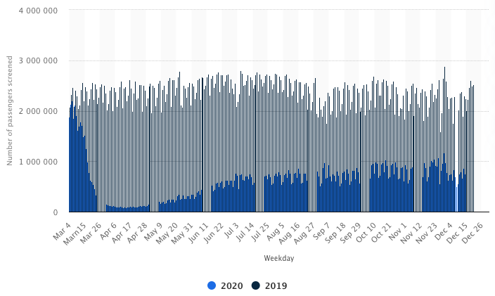
Daily number of passengers screened at TSA checkpoints in the United States from March 2019 to December 2020
Source: Statista
Notes:
Statista, downloaded 1/12/21
https://www.statista.com/statistics/1107016/coronavirus-tsa-checkpoint-travel-numbers-us-airports/

Slide 41
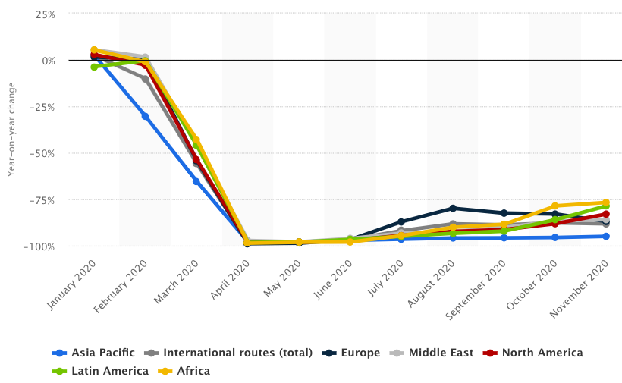
Year-on-year revenue-passenger kilometer (RPK) change on international routes from January to November 2020, by region
Source: Statista
Notes:
Statista, downloaded 1/12/21
https://www.statista.com/statistics/234977/revenue-passenger-kilometers-on-international-flights/

Slide 42
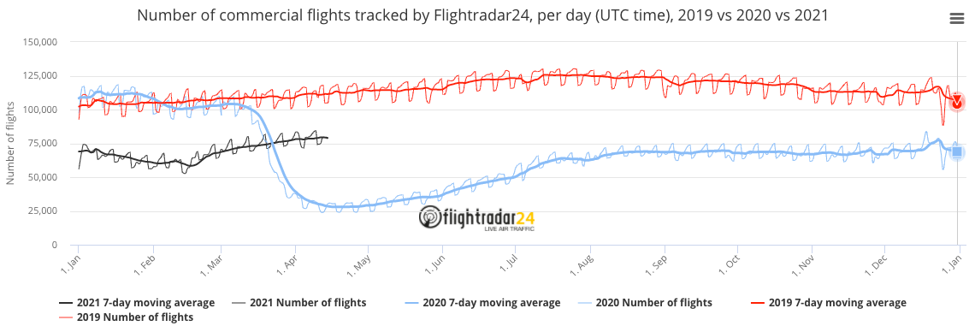
Source: flightrader24, April 15, 2021
Notes:
flightrader24, April 15, 2021
https://www.flightradar24.com/data/statistics

Slide 43
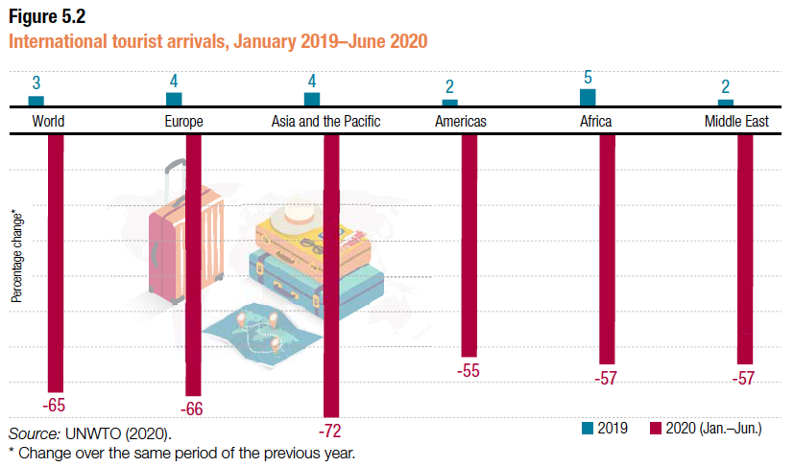
Source: UNCTAD
Notes:
UNCTAD,
https://unctad.org/webflyer/impact-covid-19-pandemic-trade-and-development-transitioning-new-normal Impact of the Covid-19 Pandemic on Trade and Development, 2020.

Slide 44
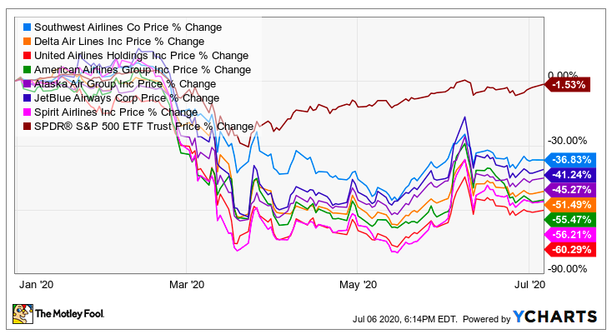
Airline Stock Prices
Notes:
The Motley Fool, July 6, 2020
https://www.fool.com/investing/2020/07/09/should-you-buy-or-sell-airline-stocks-right-now.aspx
Looked for a more recent graph, but the only one I found 1/12/21 didn’t include the broader index.

Slide 45
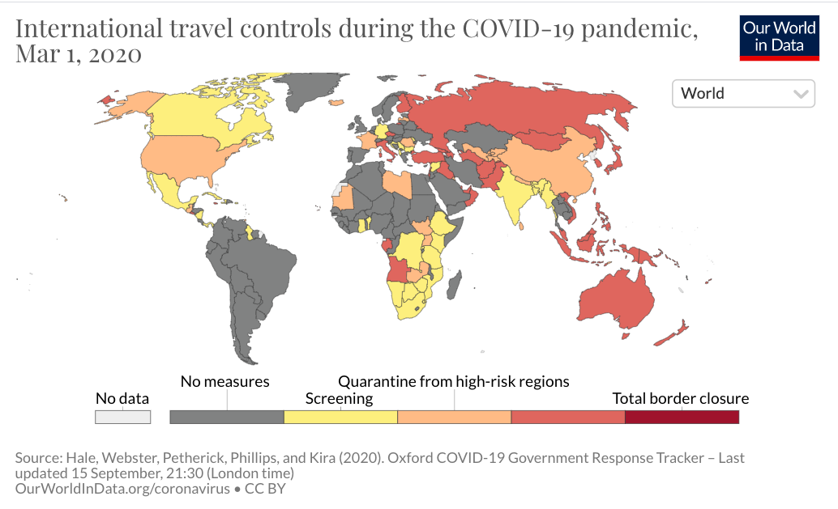
International travel controls during the COVID-19 pandemic, Mar 1, 2020
Notes:
Our World in Data
https://ourworldindata.org/grapher/international-travel-covid

Slide 46
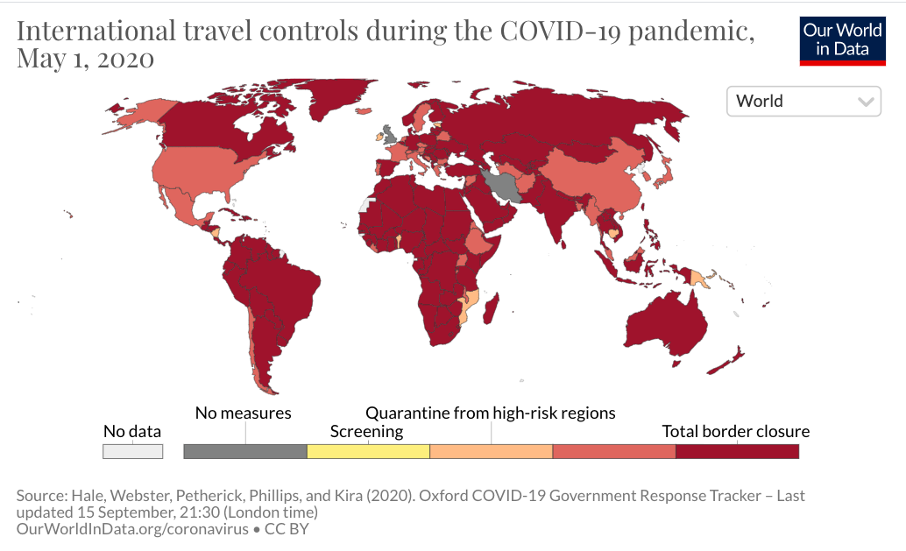
International travel controls during the COVID-19 pandemic, May 1, 2020
Notes:
Our World in Data
https://ourworldindata.org/grapher/international-travel-covid

Slide 47
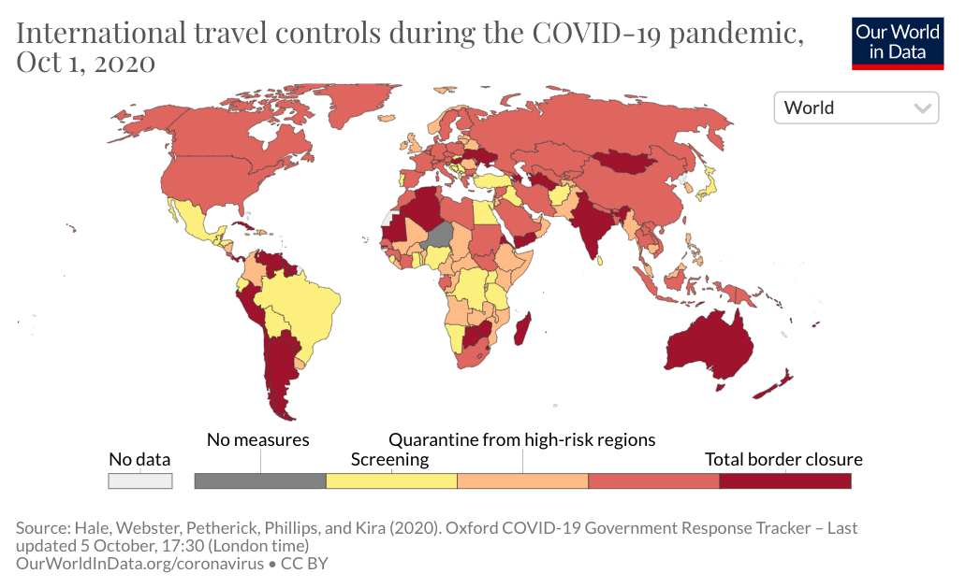
International travel controls during the COVID-19 pandemic, Oct 1, 2020
Notes:
Our World in Data
https://ourworldindata.org/grapher/international-travel-covid

Slide 48
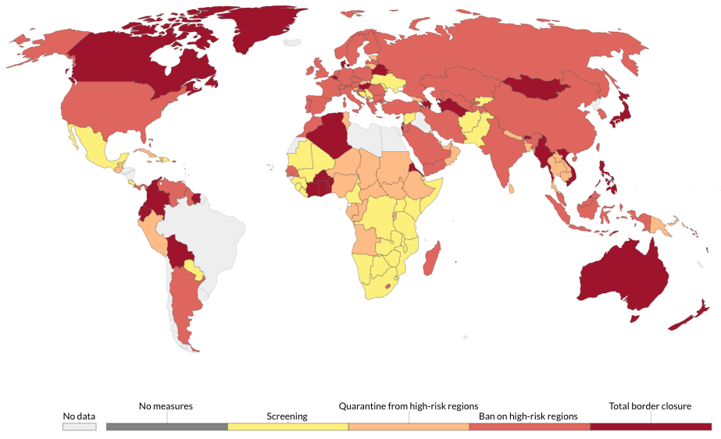
International travel controls during the COVID-19 pandemic, Apr 15, 2021
Notes:
Our World in Data
https://ourworldindata.org/grapher/international-travel-covid

Slide 49
Shipping
Effects on Economies

Slide 50
Effects on Economies
Shipping by Sea
  Drop in trade reduced demand at first
    Then increased demand for restocking
  Pandemic added restrictions
    At ports
    For crews
  Shipping rates rose

Slide 51
Shipping
Headlines on Shipping
  2021
    Apr 8 WSJ: China’s Cosco Shipping Expects Profit Surge as Industry Flourishes
    Mar 7 NYT: Chaos Strikes Global Shipping
    Feb 28 FT: China’s exporters hit by global shortage of shipping containers
    Jan 4 WSJ: Covid-19 Shipping Problems Squeeze China’s Exporters
  2020:
    Dec 10 FT: Pandemic triggers ‘perfect storm’ for global shipping supply chains
    Nov 1 FT: An SOS for the stranded seafarers who ship global trade
    Oct 10 Economist: How covid-19 put wind in shipping companies’ sails
    Sep 14 NYT: Trapped by Pandemic, Ships’ Crews Fight Exhaustion and Despair
    Jun 7 FT: Shipping industry warns of trade logjam as crews remain stranded
    Mar 6 WSJ: Coronavirus Snarls Trans-Pacific Shipping and Ripples Through U.S. Business
    Feb 28 NYT: Virus Disrupts China’s Shipping, and World Ports Feel the Impact"

Slide 52
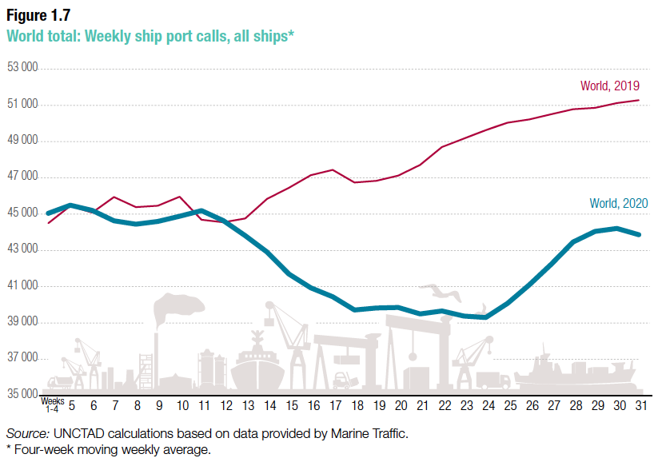
Source: UNCTAD
Notes:
UNCTAD,
https://unctad.org/webflyer/impact-covid-19-pandemic-trade-and-development-transitioning-new-normal Impact of the Covid-19 Pandemic on Trade and Development, 2020.

Slide 53
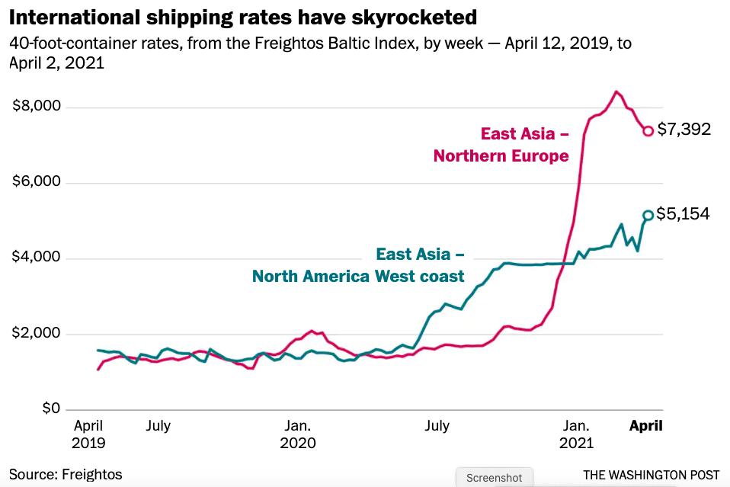
Source: Telford & Bogage, Apr 9, 2021
Notes:
Telford, Taylor and Jacob Bogage, “Essential, invisible: Covid has 200,000 merchant sailors stuck at sea,” Washington Post, April 9, 2021.
https://www.washingtonpost.com/health/2021/04/09/maritime-workers-pandemic-global-trade/?utm_campaign=wp_todays_headlines&utm_medium=email&utm_source=newsletter&wpisrc=nl_headlines&carta-url=https%3A%2F%2Fs2.washingtonpost.com%2Fcar-ln-tr%2F31d1102%2F6072c8a89d2fda1dfb4b2316%2F597273baade4e21a847d94bd%2F46%2F57%2F6072c8a89d2fda1dfb4b2316

Slide 54
Effects on Economies
Shipping by Air
  This too was hurt, as fewer passenger flights also carried less cargo

Slide 55
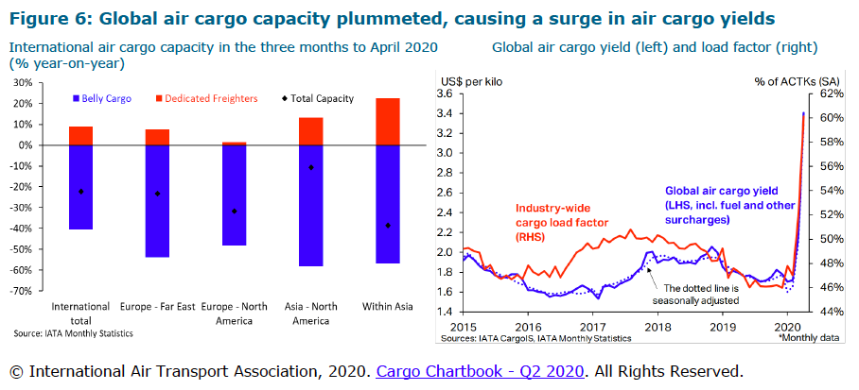
Source: WTO (2020)
Notes:
WTO, “Trade Costs in the Time of Global Pandemic,” information note, World Trade Organization, August 12, 2020.
https://www.wto.org/english/tratop_e/covid19_e/trade_costs_report_e.pdf

Slide 56
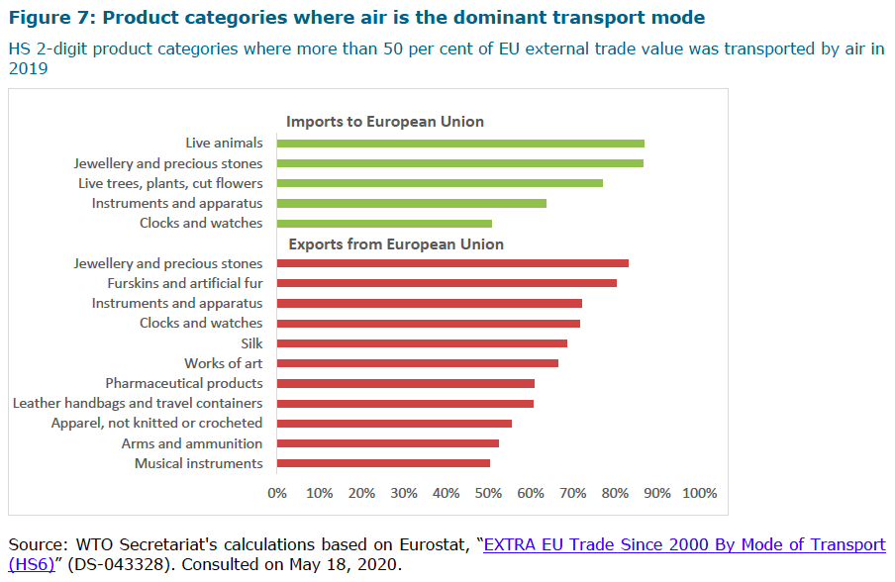
Source: WTO
(2020)
Notes:
WTO, “Trade Costs in the Time of Global Pandemic,” information note, World Trade Organization, August 12, 2020.
https://www.wto.org/english/tratop_e/covid19_e/trade_costs_report_e.pdf

Slide 57
Supply Chains
Effects on Economies

Slide 58
Effects on Economies
Supply Chains
  Globalization has created long and complex international supply chains
  These are vulnerable to the shocks of the pandemic

Slide 59

NAFTA and the Auto Supply Chain
Black, Diamond, and Merrill, “One Tiny Widget’s Dizzying Journey Shows Just How Critical Nafta Has Become,” Bloomberg, February 2, 2017.

Slide 60

NAFTA and the Auto Supply Chain
Black, Diamond, and Merrill, “One Tiny Widget’s Dizzying Journey Shows Just How Critical Nafta Has Become,” Bloomberg, February 2, 2017.

Slide 61

NAFTA and the Auto Supply Chain
Black, Diamond, and Merrill, “One Tiny Widget’s Dizzying Journey Shows Just How Critical Nafta Has Become,” Bloomberg, February 2, 2017.

Slide 62

NAFTA and the Auto Supply Chain
Black, Diamond, and Merrill, “One Tiny Widget’s Dizzying Journey Shows Just How Critical Nafta Has Become,” Bloomberg, February 2, 2017.

Slide 63

NAFTA and the Auto Supply Chain
Black, Diamond, and Merrill, “One Tiny Widget’s Dizzying Journey Shows Just How Critical Nafta Has Become,” Bloomberg, February 2, 2017.

Slide 64

NAFTA and the Auto Supply Chain
Black, Diamond, and Merrill, “One Tiny Widget’s Dizzying Journey Shows Just How Critical Nafta Has Become,” Bloomberg, February 2, 2017.

Slide 65
Supply Chains
Example: The iPhone assembled in China from parts:
Part | Come from
﻿Accelerometers | ﻿Germany, the US, South Korea, China, Japan, and Taiwan.
﻿Audio chips | ﻿US, UK, China, South Korea, Taiwan, Japan, and Singapore.
﻿Batteries | ﻿Samsung (South Korea), which has factories in eighty countries.
﻿Cameras | ﻿Qualcomm (US) and Sony (Japan), both with plants in many countries
﻿Chips ﻿for 3G/4G/LTE networking | ﻿Qualcomm (US)
﻿Compasses | ﻿AKM Semiconductor (Japan) with plants in the US, France, England, China, South Korea, and Taiwan.
﻿Glass screen | ﻿Corning (US) with plants in twenty-six countries.
﻿Gyroscopes | Switzerland
… and many more
Source: Krueger 2020
Notes:
Krueger, Anne O., International Trade (What Everyone Needs to Know) (p. 254). Oxford University Press, 2020

Slide 66
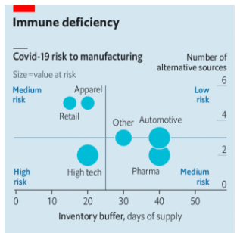
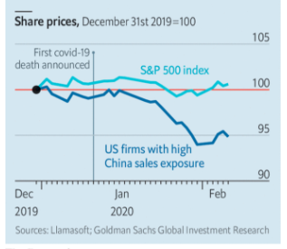
The new coronavirus could have a lasting impact on global supply chains
2021 Chip Shortage
What sectors are most vulnerable?
Those with small inventories and few alternative sources.
Source: Economist Feb 15, 2020
Notes:
Economist Feb 15, 2020
https://www.economist.com/international/2020/02/15/the-new-coronavirus-could-have-a-lasting-impact-on-global-supply-chains

Slide 67
Supply Chains
Headlines on supply chains:
  2021:
    Mar 24 FT: Pandemic reveals weak links in global supply chain
    Mar 22 FT: Unvaccinated sailors risk deepening global supply chain crisis
    Feb 24: WP: Biden to order sweeping review of U.S. supply chain weak spots
  2020:
    Dec 19 Economist: Is a wave of supply-chain reshoring around the corner?
    Dec 10 FT: Pandemic triggers ‘perfect storm’ for global shipping supply chains
    Sep 9 FT: Stranded crews pose a risk to supply chains
    Aug 23 “Pandemic shows US must make vital products at home” (Kevin McCarthy [House Minority Leader]
    Aug 8 FT: Covid-19 and other risks mean quarter of products could be sourced from new countries in 5 years
    May 26 WSJ: Steep Drop in Trade Flows Shows Pitfalls of Cross-Border Supply Chains
    May 11 FT: Covid-19 crisis has laid bare weaknesses in supply chains

Slide 68
Effects on Economies
Other Supply Chain Vulnerabilities
  Brexit
  Texas storm and freeze
  Suez blockage
  Ban on imports from Xinjiang, China
  Chip shortage

Slide 69
Effects on Economies
Effects on Other Aspects of Economies
    (if time)
  GDP
  Unemployment

Slide 70
GDP
Effects on Economies

Slide 71
Effects on Economies
GDP
  World GDP was expected to decline, and did
    More than in the 2009 recession
    Although it then rose, it never reached its previous trend, so the loss is ongoing
    Drop was worst across much of manufacturing
  Fall in income caused fall in migrant remittances

Slide 72
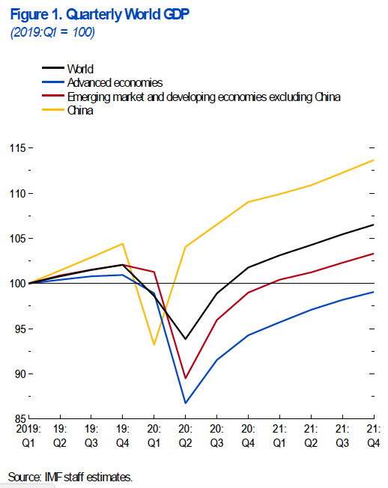
Source: IMF June 2020
Notes:
IMF World Economic Outlook Update, June 2020
https://www.imf.org/en/Publications/WEO/Issues/2020/06/24/WEOUpdateJune2020

Slide 73
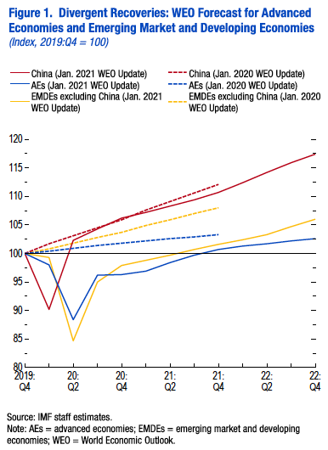
Source: IMF Jan 2021
Notes:
IMF World Economic Outlook Update, January 2021
https://www.imf.org/-/media/Files/Publications/WEO/2021/Update/January/English/text.ashx

Slide 74
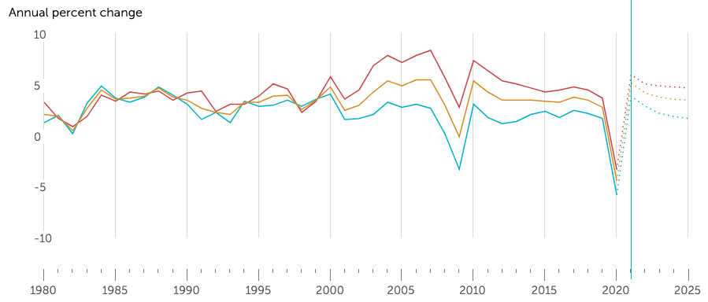

Historical and projected change in world real GDP
2021
forecast
Source: IMF, Jan 12, 2021
Notes:
IMF DataMapper, Jan 12 2021
https://www.imf.org/external/datamapper/NGDP_RPCH@WEO/OEMDC/ADVEC/WEOWORLD

Slide 75
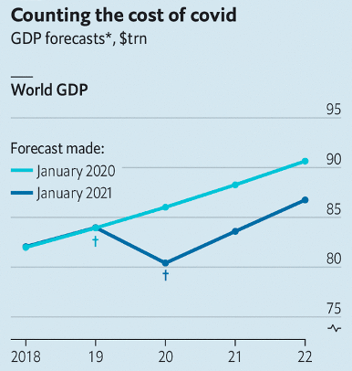
GDP shortfall due to covid:
2020: 6.6% or $5.6 trn
2021+: less but continuing
Also: GDP includes production for covid that would have been for other valued things.
$5.6trn
Source: Economist Jan 9, 2021
Notes:
Economist, “Covid-10trn: What is the economic cost of covid-19?” January 9, 2021.
https://www.economist.com/finance-and-economics/2021/01/09/what-is-the-economic-cost-of-covid-19

Slide 76
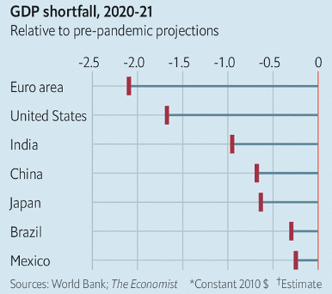
Source: Economist Jan 9, 2021
Notes:
Economist, “Covid-10trn: What is the economic cost of covid-19?” January 9, 2021.
https://www.economist.com/finance-and-economics/2021/01/09/what-is-the-economic-cost-of-covid-19

Slide 77
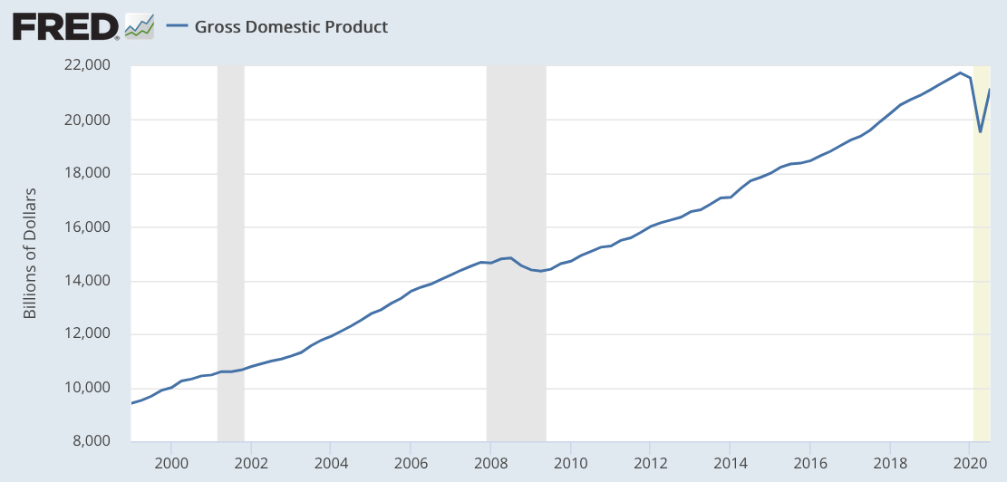
United States Gross Domestic Product
Source: FRED Updated Jan 13, 2021
Notes:
FRED Updated Jan 13, 2021
https://fred.stlouisfed.org/series/GDP

Slide 78
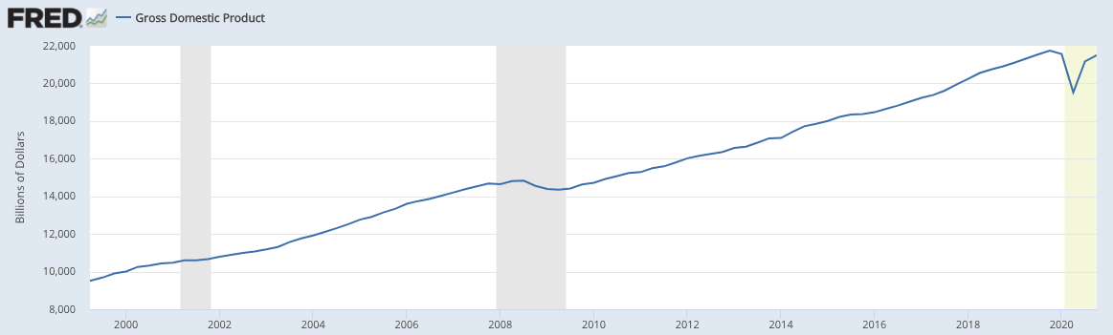
United States Gross Domestic Product
Source: FRED Updated Apr 27, 2021
Notes:
FRED Updated Apr 27, 2021
https://fred.stlouisfed.org/series/GDP

Slide 79
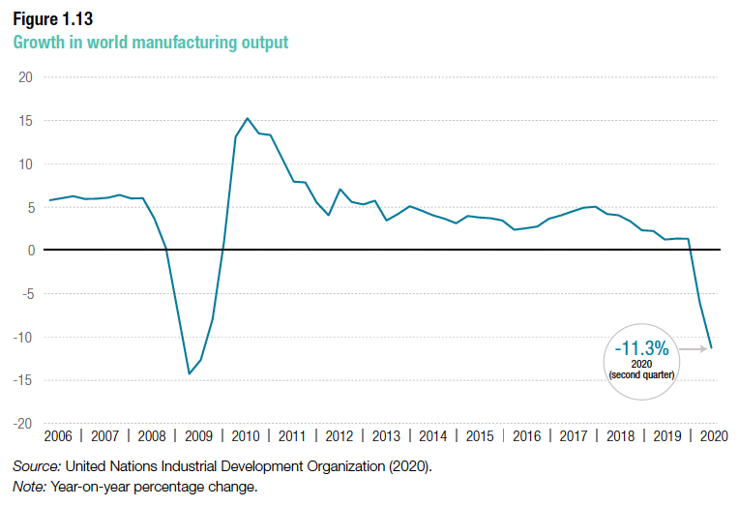
Source: UNCTAD
Notes:
UNCTAD,
https://unctad.org/webflyer/impact-covid-19-pandemic-trade-and-development-transitioning-new-normal Impact of the Covid-19 Pandemic on Trade and Development, 2020.

Slide 80
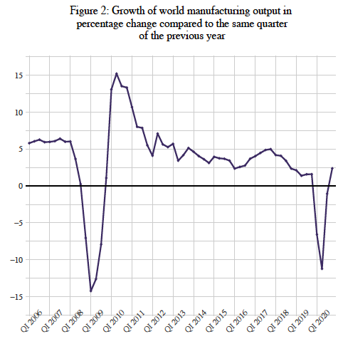
Source: UNIDO
Notes:
UNIDO, World Manufacturing Production, Q4 2020
https://stat.unido.org/admin/publicationPdf;jsessionid=D0C5549727D1CEB2000326570716A028?World_Manufacturing_Production_2020_Q4.pdf

Slide 81
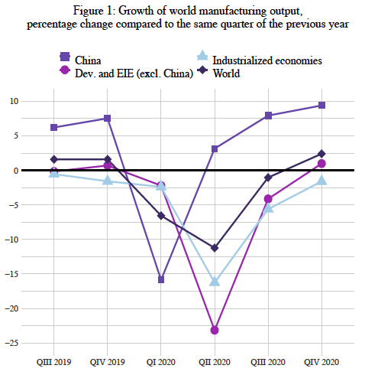
Source: UNIDO
Notes:
UNIDO, World Manufacturing Production, Q4 2020
https://stat.unido.org/admin/publicationPdf;jsessionid=D0C5549727D1CEB2000326570716A028?World_Manufacturing_Production_2020_Q4.pdf

Slide 82
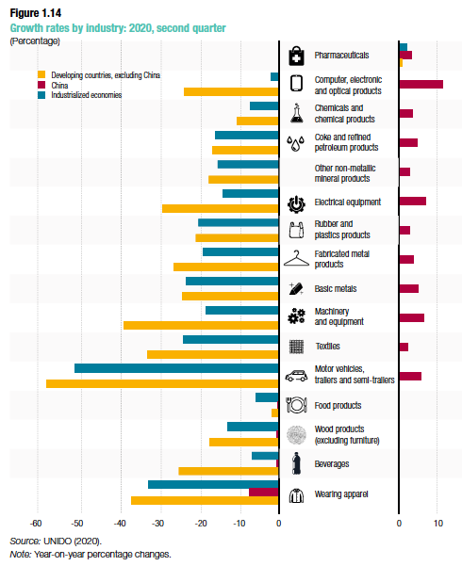
Source: UNCTAD
Notes:
UNCTAD,
https://unctad.org/webflyer/impact-covid-19-pandemic-trade-and-development-transitioning-new-normal Impact of the Covid-19 Pandemic on Trade and Development, 2020.

Slide 83
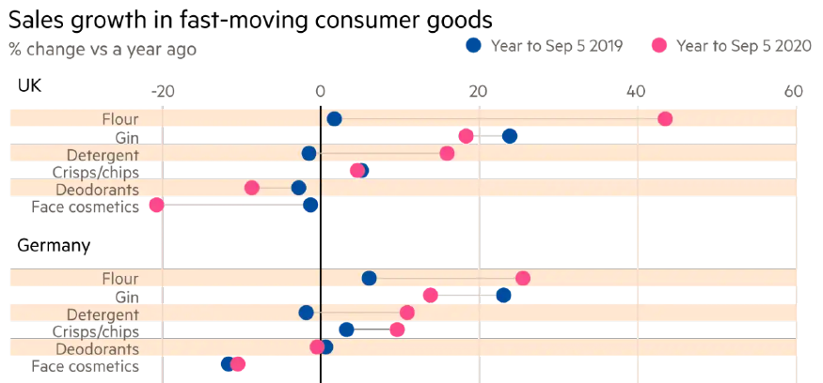
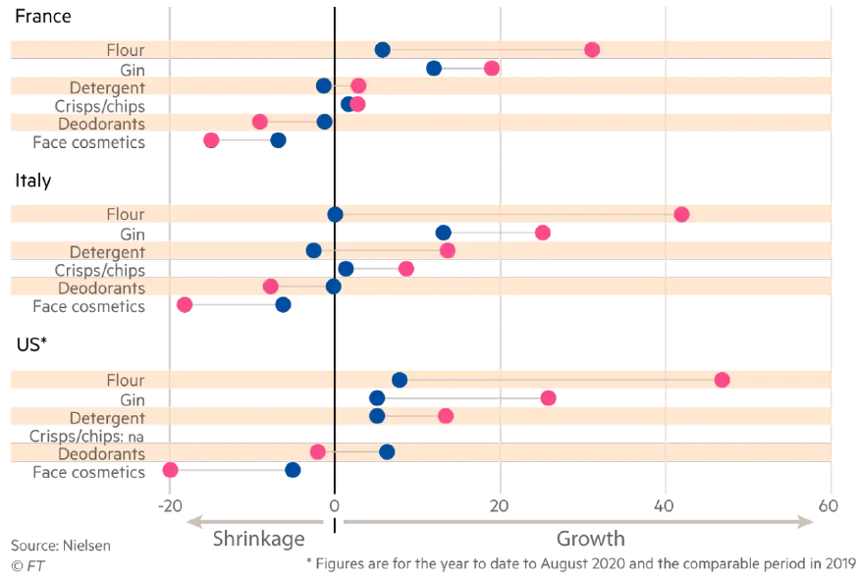
Source: Evans (2020)
Notes:
Evans, Judith, “The post-Covid consumer: is back-to-basics shopping here to stay?” Financial Times, November 1, 2020.
https://www.ft.com/content/ce2b0f65-f98a-49cc-b258-7eb8cc257cc4

Slide 84
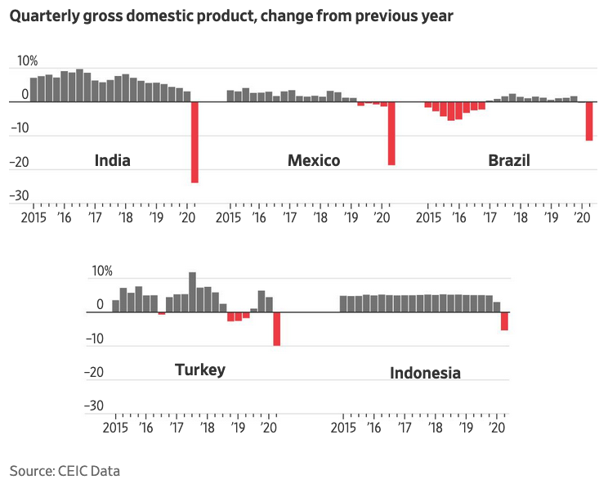
Source:
Notes:
Vyas, Kejal and Vibhuti Agarwal, “Covid-19 Pandemic Ravages World’s Largest Developing Economies,” Wall Street Journal, September 3, 2020.
https://www.wsj.com/articles/covid-19-pandemic-ravages-worlds-largest-developing-economies-11599171833

Slide 85
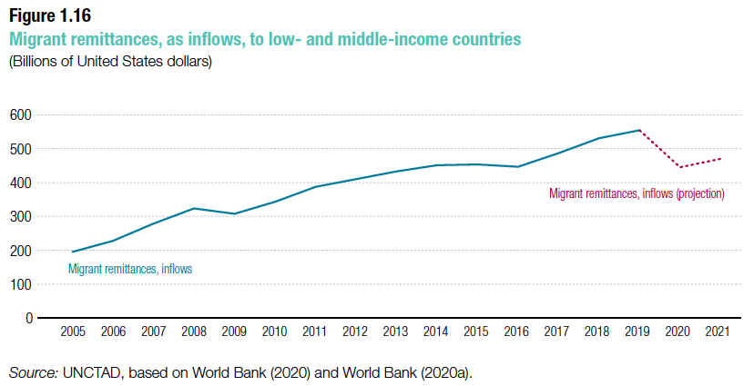
Source: UNCTAD
Notes:
UNCTAD,
https://unctad.org/webflyer/impact-covid-19-pandemic-trade-and-development-transitioning-new-normal Impact of the Covid-19 Pandemic on Trade and Development, 2020.

Slide 86
Unemployment
Effects on Economies

Slide 87
Effects on Economies
Unemployment
  Pandemic has caused recession in most of the world, and increased unemployment
  US unemployment rose much more than EU and other developed countries
  Internationally, increases rise with Covid-19 cases
  Job vacancies dropped, often by 40% or more, and have only partially recovered

Slide 88
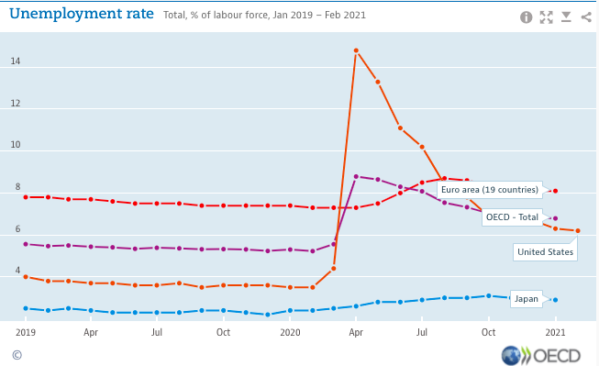
Source: OECD
Notes:
OECD, “Unemployment Rates, OECD - Updated: March 2021
https://www.oecd.org/newsroom/unemployment-rates-oecd-update-march-2021.htm

Slide 89
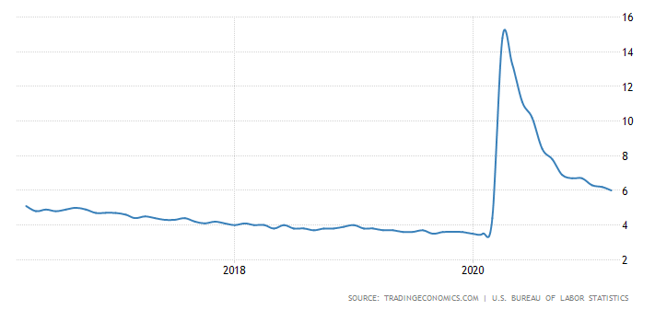
United States Unemployment Rate
Source: Trading Economics
Notes:
Trading Economics
https://tradingeconomics.com/united-states/unemployment-rate#:~:text=Unemployment%20Rate%20in%20the%20United,percent%20in%20May%20of%201953.

Slide 90
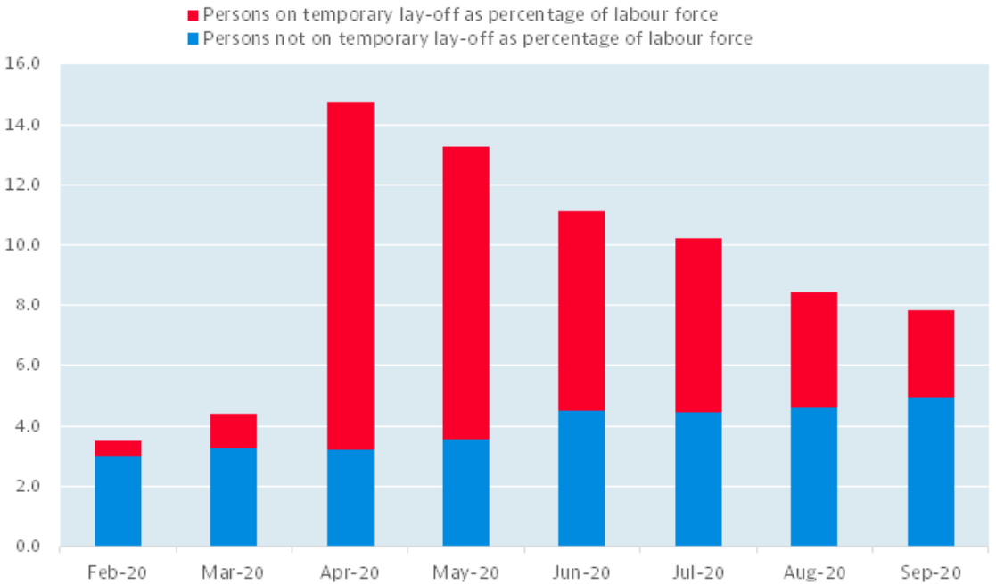
Source: OECD

Slide 91
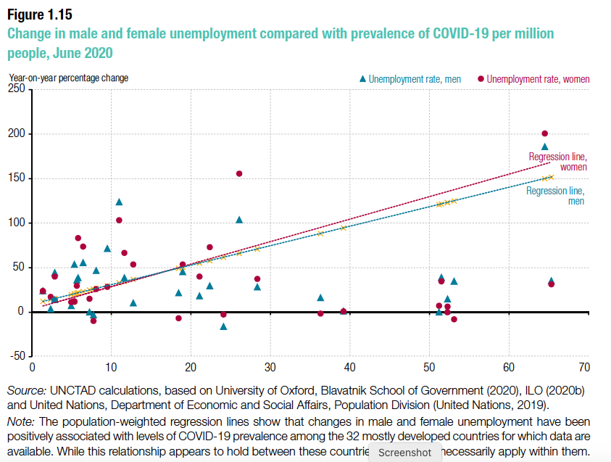
Source: UNCTAD
Notes:
UNCTAD,
https://unctad.org/webflyer/impact-covid-19-pandemic-trade-and-development-transitioning-new-normal Impact of the Covid-19 Pandemic on Trade and Development, 2020.

Slide 92
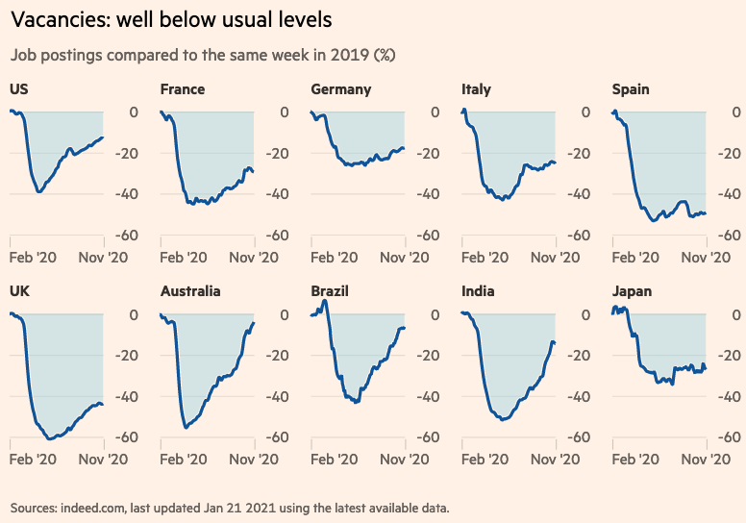
Source: Financial Times
January 25, 2021
Notes:
FT Reporteers, “Pandemic crisis: Global economic impact tracker,” Financial Times, January 25, 2021
https://www.ft.com/content/272354f2-f970-4ae4-a8ae-848c4baf8f4a

Slide 93
Effects on Trade Policies

Slide 94

Source: Hoekman et al. (2020)
Notes:
Hoekman, Bernard, Anirudh Shingal, Varun Eknath and Viktoriya Ereshchenko, “COVID-19, public procurement regimes and trade policy,” EUI Working Paper RSCAS 2020/72, European University Institute, November 2020.
https://cadmus.eui.eu/bitstream/handle/1814/68839/RSCAS_2020_72.pdf?sequence=1&isAllowed=y

Slide 95

Countries with only export restriction, extending beyond 2020
Trade Policy Responses: Who did what for how long?
Countries with both import facilitation and export restriction, extending beyond 2020
USA
Inc. Italy
Inc. India
Brazil
China
Countries differ greatly in the nature of their interventions
Countries with only import facilitation, extending beyond 2020
Inc. Canada
Source: Evenett et al.
Notes:
Evenett, Simon, Matteo Fiorini, Johannes Fritz, Bernard Hoekman, Piotr Lukaszuk, Nadia Rocha,Michele Ruta, Filippo Santi, Anirudh Shingal, “Trade policy responses to the COVID-19 pandemic: Evidence from a new dataset,” VOXEU, December 11, 2020.
https://voxeu.org/article/trade-policy-responses-covid-19-pandemic-new-dataset

Slide 96
Effects on Trade Policies
Effects of the Pandemic on Trade Policies
  Export Policies
  Import Policies

Slide 97
Export Policies
Effects on Trade Policies

Slide 98
Effects on Export Policies
Export Policies
  There were export bans by many countries on
    Medical supplies
    Food
    Other
  Some were temporary, but many others were not
  Only a few countries had policies to encourage exports

Slide 99
Effects on Export Policies
Headlines on Export bans
  2020:
    Jun 24, NYT: Warren and Booker Press Meatpackers on Exports to China
    May 28, WSJ: ‘Vaccine Nationalism’: A New Dynamic in the Race to Quash Coronavirus
    Apr 11, WSJ: China Tightens Customs Checks for Medical Equipment Exports
    Apr 8, WSJ: U.S. to Restrict Mask, Glove Exports for Four Months During Coronavirus Pandemic
    Apr 8, WP: As borders harden during pandemic, some countries look to hold on to their own food
    Apr 3, Reuters: Trade Restrictions on Food Exports Due to the Coronavirus Pandemic
    Mar 19, VOX^{EU}: Sickening thy neighbour: Export restraints on medical supplies during a pandemic

Slide 100


Source: ITC
Notes:
ITC Market Access Map
https://www.macmap.org/covid19

Slide 101

Source: WTO (2020)
Notes:
WTO, “Report on G-20 Trade Measures (Mid-October 2019 to Mid-May 2020),” World Trade Organization, June 29, 2020.
https://www.wto.org/english/news_e/news20_e/report_trdev_jun20_e.pdf

Slide 102

Source: WTO (2020)
Notes:
WTO, “Report on G-20 Trade Measures (Mid-October 2019 to Mid-May 2020),” World Trade Organization, June 29, 2020.
https://www.wto.org/english/news_e/news20_e/report_trdev_jun20_e.pdf

Slide 103
Import Policies
Effects on Trade Policies

Slide 104
Effects on Import Policies
Effects of the Pandemic on Import Policies
  Import expansion
    Tariff reductions
  Import contraction
    Tariff increases
    Import bans
    Government procurement

Slide 105
Effects on Import Policies
Headlines on Import Expansion
  2020:
    Apr 20 FT: Trump exempts virus-hit US businesses from import tariffs
    Apr 13 WSJ: U.S. Tariffs Hamper Imports of Sanitizer, Disinfectants, Some Companies Say
    Apr 2 NYT: Trump Rebuffs Demands to Lift Tariffs as Economy Falters
    Mar 31 FT: Trump to suspend some tariffs for 90 days
    Mar 26 WSJ: U.S. Will Approve Some Delays in Tariff Payments Amid Coronavirus Crisis
    Mar 24 FT: Drop the tariffs and save some lives. Quick
    Mar 19 WSJ: Trump Spurns Business Plea to Ease Tariffs Amid Coronavirus
    Mar 16 NYT: U.S. Weighs Tariff Relief but Some Fear China Will Take Advantage

Slide 106
Effects on Import Policies
Headlines on Import Contraction
  2020:
    Aug 23 FT: McCarthy: Pandemic shows US must make vital products at home
    Aug 17 FT: Guangzhou bans frozen meat imports over virus fears
    Aug 6 FT: Donald Trump to order government to buy medicines from US companies
    May 30 WSJ: Protectionism Spreads Globally With the New Coronavirus
    May 10 FT: U.S. Multinationals fear rise in protectionism because of pandemic

Slide 107


Source: ITC
Notes:
ITC Market Access Map
https://www.macmap.org/covid19

Slide 108
Trade during the Pandemic

Slide 109
Role of Trade During Pandemic
Trade in COVID-19 Critical Goods
  Trade increased, especially in PPE but also medical
  Largest importer was US, both before and during
  Largest exporter, after a lag, was China
  Facemasks
    Textile facemasks grew most
    As did China’s imports of the textiles
    In spite of high import tariffs
Notes:
“Trade in Medical Goods in the Context of Tackling COVID-19: Developments in the First Half of 2020,” Information Note, World Trade Organization, December 22, 2020
https://www.wto.org/english/tratop_e/covid19_e/medical_goods_update_e.pdf

Slide 110

Source: UNCTAD
Notes:
UNCTAD,
https://unctad.org/webflyer/impact-covid-19-pandemic-trade-and-development-transitioning-new-normal Impact of the Covid-19 Pandemic on Trade and Development, 2020.

Slide 111

Source: WTO
Notes:
“Trade in Medical Goods in the Context of Tackling COVID-19: Developments in the First Half of 2020,” Information Note, World Trade Organization, December 22, 2020
https://www.wto.org/english/tratop_e/covid19_e/medical_goods_update_e.pdf

Slide 112

Source: WTO
Notes:
“Trade in Medical Goods in the Context of Tackling COVID-19: Developments in the First Half of 2020,” Information Note, World Trade Organization, December 22, 2020
https://www.wto.org/english/tratop_e/covid19_e/medical_goods_update_e.pdf

Slide 113

Source: WTO
Notes:
“Trade in Medical Goods in the Context of Tackling COVID-19: Developments in the First Half of 2020,” Information Note, World Trade Organization, December 22, 2020
https://www.wto.org/english/tratop_e/covid19_e/medical_goods_update_e.pdf

Slide 114
Role of Trade During Pandemic
Trade counterfeit goods
  Ramirez reports, from OECD data, that
    Criminal organisations have taken advantage of public fear to sell defective PPE and COVID-19 tests, faulty ventilators and other medical products, and even fictitious treatments and miracle cures
Notes:
“Trade in Medical Goods in the Context of Tackling COVID-19: Developments in the First Half of 2020,” Information Note, World Trade Organization, December 22, 2020
https://www.wto.org/english/tratop_e/covid19_e/medical_goods_update_e.pdf

Slide 115

Source:
Ramirez (2020)
Notes:
Ramirez, David, “COVID-19: Global trade and supply chains after the pandemic,” IISS, The International Institute for Strategic Studies, Research paper, August 27. 2020.
https://www.iiss.org/blogs/research-paper/2020/08/covid-19-trade-and-supply-chains

Slide 116
Role of Trade During Pandemic
Vaccines
  Vaccine industry relies heavily on trade
  Concerns
    Distribution to the poorest countries
    Reluctance to be vaccinated
    Vaccine nationalism
Notes:
“Trade in Medical Goods in the Context of Tackling COVID-19: Developments in the First Half of 2020,” Information Note, World Trade Organization, December 22, 2020
https://www.wto.org/english/tratop_e/covid19_e/medical_goods_update_e.pdf

Slide 117

Source: WTO, Dec 22, 2020
Notes:
WTO, “Developing and Delivering Covid-19 Vaccines around the World,” information note, World Trade Organization, December 22, 2020.
https://www.wto.org/english/tratop_e/covid19_e/vaccine_report_e.pdf

Slide 118

Source: Bloomberg, Apr 15, 2021
Notes:
Randall, Tom, Cedric Sam, Andre Tartar, Christopher Cannon, and Paul Murray, “More Than 245 Million Shots Given: Covid-19 Vaccine Tracker,” Bloomberg, March 1, 2021
https://www.bloomberg.com/graphics/covid-vaccine-tracker-global-distribution/

Slide 119

Source: Economist Feb 6. 2021
Notes:
Economist, “Africa’s recovery from covid-19 will be slow,” The Economistci, Febuary 6, 2021
https://www.economist.com/middle-east-and-africa/2021/02/06/africas-recovery-from-covid-19-will-be-slow

Slide 120

Agreement that “vaccines are safe”
Source:
Kuman
(December 2020)
Notes:
Kumar, Ravi, “Business has a big role to play in vaccinating the world,” World Economic Forum, December 15, 2020.
https://www.weforum.org/agenda/2020/12/business-has-a-big-role-to-play-in-vaccinating-the-world/

Slide 121

Source: Economist Feb 13, 2021
Notes:
Economist, “Fear, uncertainty and doubt: Vaccine hesitancy is putting progress against covid-19 at risk,” The Economist, Feb 13, 2021
https://www.economist.com/briefing/2021/02/13/vaccine-hesitancy-is-putting-progress-against-covid-19-at-risk

Slide 122
Vaccine Nationalism
Vaccine Nationalism
  Some countries seek to restrict exports of vaccines until their own populations are served.
  On Jan 29, the EU announced export controls on COVID-19 vaccines, scheduled to lapse March 31
  Since then repeated news of vaccine export controls
  I have had audience members hope that the US will not export vaccines until all Americans are vaccinated
  If this were done, it would slow the world’s progress toward managing the pandemic
Notes:
https://iccwbo.org/media-wall/news-speeches/study-shows-vaccine-nationalism-could-cost-rich-countries-us4-5-trillion/
https://foreignpolicy.com/2021/02/02/vaccine-nationalism-harms-everyone-and-protects-no-one/
https://www.theguardian.com/commentisfree/2021/feb/02/vaccine-nationalism-hiv-covid
https://www.newscientist.com/article/mg24933201-800-vaccine-nationalism-will-leave-everyone-more-at-risk-of-coronavirus/
https://fortune.com/2021/01/31/covid-vaccine-nationalism-coronavirus-pandemic-length-when-will-it-end/

Slide 123

Source: Washington Post Apr 22, 2021
Notes:
Mirza, Atthar and Emily Rauhala, “Here’s just how unequal the global coronavirus vaccine rollout has been,” Washington Post, April 22, 2021.
https://www.washingtonpost.com/world/interactive/2021/coronavirus-vaccine-inequality-global/?utm_campaign=wp_todays_headlines&utm_medium=email&utm_source=newsletter&wpisrc=nl_headlines&carta-url=https%3A%2F%2Fs2.washingtonpost.com%2Fcar-ln-tr%2F3205385%2F6083ec299d2fda39cec7c8a4%2F597273baade4e21a847d94bd%2F15%2F57%2F6083ec299d2fda39cec7c8a4

Slide 124


Source:
Notes:
https://ourworldindata.org/covid-vaccinations

Slide 125

Source:
Notes:
https://ourworldindata.org/covid-vaccinations

Slide 126

Source: Economist, April 3, 2021
Notes:
Economist, “Spreading the Needle: Almost one billion doses of covid-19 vaccines have been produced,” The Economist, April 3, 2021
https://www.economist.com/international/2021/03/31/almost-one-billion-doses-of-covid-19-vaccines-have-been-produced

Slide 127
Vaccine Nationalism
COVAX
  An initiative launched the World Health Organization, the European Commission, and France to provide vaccines to people in all countries regardless of wealth
  Apr 8, 2021: “COVAX reaches over 100 economies, 42 days after first international delivery”
Notes:
https://iccwbo.org/media-wall/news-speeches/study-shows-vaccine-nationalism-could-cost-rich-countries-us4-5-trillion/
https://foreignpolicy.com/2021/02/02/vaccine-nationalism-harms-everyone-and-protects-no-one/
https://www.theguardian.com/commentisfree/2021/feb/02/vaccine-nationalism-hiv-covid
https://www.newscientist.com/article/mg24933201-800-vaccine-nationalism-will-leave-everyone-more-at-risk-of-coronavirus/
https://fortune.com/2021/01/31/covid-vaccine-nationalism-coronavirus-pandemic-length-when-will-it-end/

Slide 128

Source: McCarthy, Feb 22, 2021
Notes:
McCarthy, Niall, “The Governments Donating The Most Money To COVAX,” Statista, Feb 22, 2021
https://www.statista.com/chart/24244/donations-to-covax-by-country/

Slide 129

Source:
UNICEF
Covid-19 Vaccine Market Dashboard
April 14, 2021
Notes:
https://app.powerbi.com/view?r=eyJrIjoiNmE0YjZiNzUtZjk2OS00ZTg4LThlMzMtNTRhNzE0NzA4YmZlIiwidCI6Ijc3NDEwMTk1LTE0ZTEtNGZiOC05MDRiLWFiMTg5MjAyMzY2NyIsImMiOjh9&pageName=ReportSectiona329b3eafd86059a947b

Slide 130
Conclusion
The Covid-19 Pandemic has had
  Devastating effects on the global economy
  Serious effects on global trade
  Mostly adverse effects on international trade policies
How much of this will be permanent remains to be seen

Slide 131
Thank you!
Thank you!
Any Questions?
Alan V. Deardorff
Ford School of Public Policy
University of Michigan
www.NEEDelegation.org

